Slide 1

DETR Model Improvements ECE508-02
By: Michael Schmidt
(A20460468)

Slide 2

Table Of Contents
Introduction (Objective)
Evaluation
Conclusion
Baseline Model
Improvements Made

Slide 3
Introduction

Slide 4




Introduction
Objective:
Improve the performance of DETR model:
Improve Detection Accuracy
Improve Training efficiency
Improve Computational Complexity
Methods of Evaluations:
Training speed
IoU metrics
Inference Speed
#Params
Improve Training
Improve Detection
Improve Computation

Slide 5
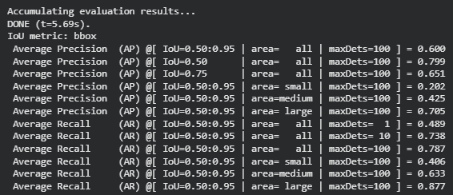
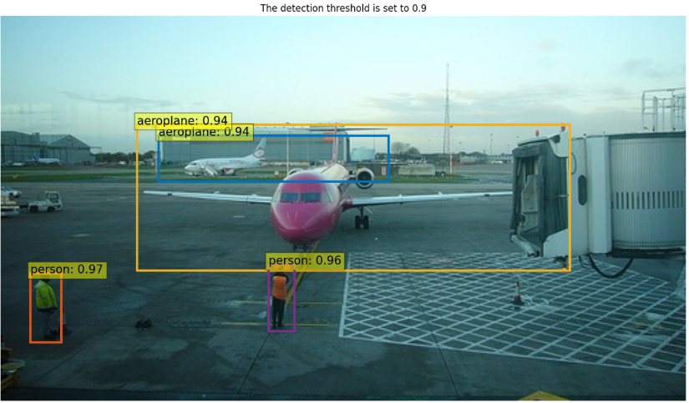
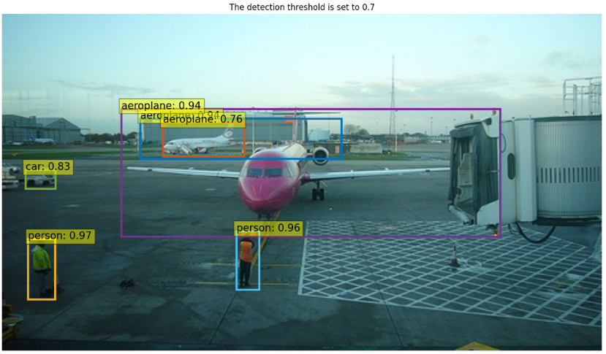
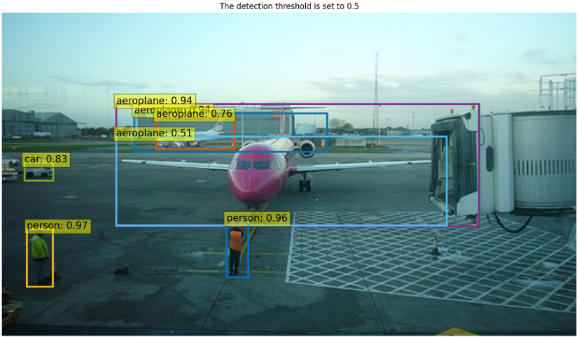
Introduction
Hyperparam Limits:
LR = 5e-5
Weight decay = 1e-4
Epochs = 10
Batch size = 4
Training Data:
Custom PASCAL VOC
20 Classes (Aeroplane, bird, cat, etc)
5717 training images
5823 testing
Training time: ~160 minutes
Accuracy = 60%
Avg Inference time = 0.0844
#Params = 41,506,778

Slide 6
Baseline Model (DETR)

Slide 7
Baseline Model (DETR)
CNN Backbone
(Feature Extraction)
Transformer Encoder-Decoder
(Self-Attention, Object queries, FFN, etc)
Prediction + Hungarian Matching
Source:
N. Carion, F. Massa, G. Synnaeve, N. Usunier, A. Kirillov, and S. Zagoruyko,
“End-to-End Object Detection with Transformers,” arXiv preprint arXiv:2005.12872, 2020.

Slide 8
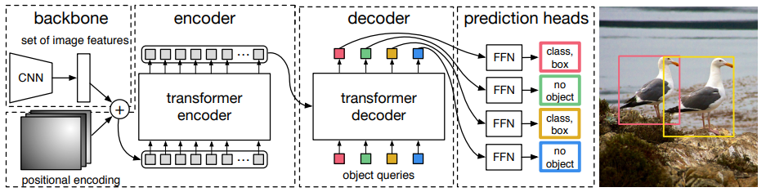
Baseline Model (DETR)
Flattens Features
6 layers:
Multi-head self attention
FFN
100 object queries
6 layers:
MHSA among queries
Cross-attention
FFN
Matching trains queries:
Should be object here
Should stay quiet
Positional Sinusoids for PE
Source:
N. Carion, F. Massa, G. Synnaeve, N. Usunier, A. Kirillov, and S. Zagoruyko,
“End-to-End Object Detection with Transformers,” arXiv preprint arXiv:2005.12872, 2020.

Slide 9
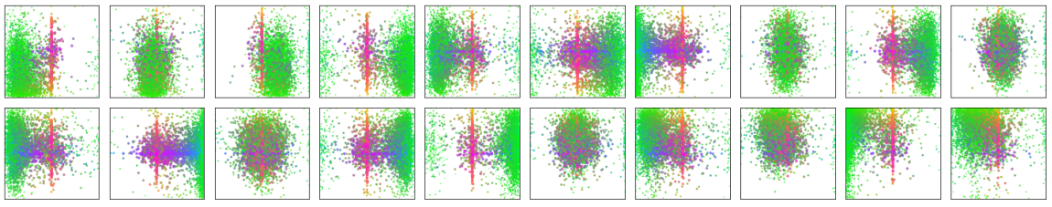
Baseline Model (DETR)
Visualization of 20 out of 100 predictions on COCO 2017 val set:
Each box represents what a query sees for BB
Points are center point of each BB
Green is small boxes
Red Large horizontal boxes
Blue large vertical boxes
Source:
N. Carion, F. Massa, G. Synnaeve, N. Usunier, A. Kirillov, and S. Zagoruyko,
“End-to-End Object Detection with Transformers,” arXiv preprint arXiv:2005.12872, 2020.

Slide 10
Improvements MAde

Slide 11
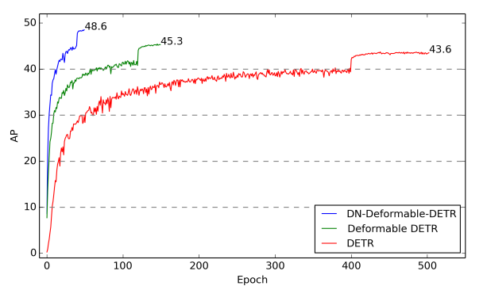
Improvement #1 (Improve Accuracy)
Problem:
DETR is slow to converge
Solution:
Implement Denoising strategies
Speeds up convergence
Query predictions stabilize faster
Improved accuracy with little overhead
Source:
F. Li, H. Zhang, S. Liu, J. Guo, L. M. Ni, and L. Zhang, “DN-DETR: Accelerate DETR Training by Introducing Query DeNoising,” arXiv:2203.01305, 2022.

Slide 12
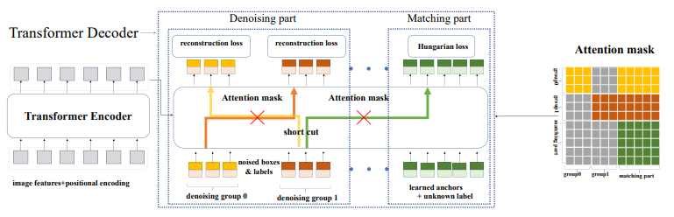
Improvement #1 (Improve Accuracy)
How it works:
Adds new “Denoising queries” to the decoder
Gives model “easy training examples” early on
Creates two groups per image
Positive examples: GT label + slightly perturb BB
Negative examples: wrong labels + corrupt BB
No matching, assignments are fixed
Since assignments are fixed, loss calculations are only:
L1 loss between GT BB and pred BB
GIoU loss
Cross-entrophy for correct class
Source:
F. Li, H. Zhang, S. Liu, J. Guo, L. M. Ni, and L. Zhang, “DN-DETR: Accelerate DETR Training by Introducing Query DeNoising,” arXiv:2203.01305, 2022.

Slide 13
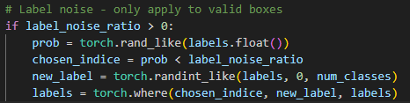
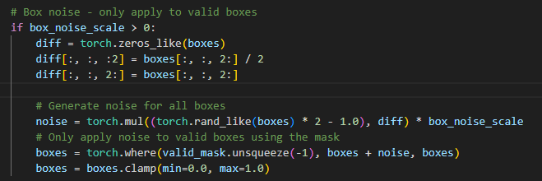
Improvement #1 (Improve Accuracy)
Calculating Noise for DN examples
For Positive examples
Labels stay the same
Use BB corruption
For Negative Examples
Label is corrupt
Use BB corruption
Source:
F. Li, H. Zhang, S. Liu, J. Guo, L. M. Ni, and L. Zhang, “DN-DETR: Accelerate DETR Training by Introducing Query DeNoising,” arXiv:2203.01305, 2022.

Slide 14
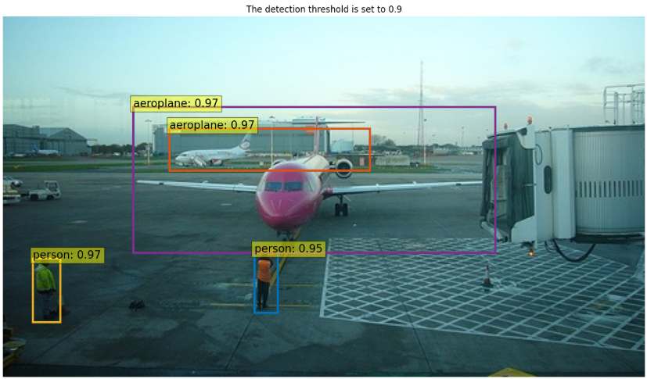
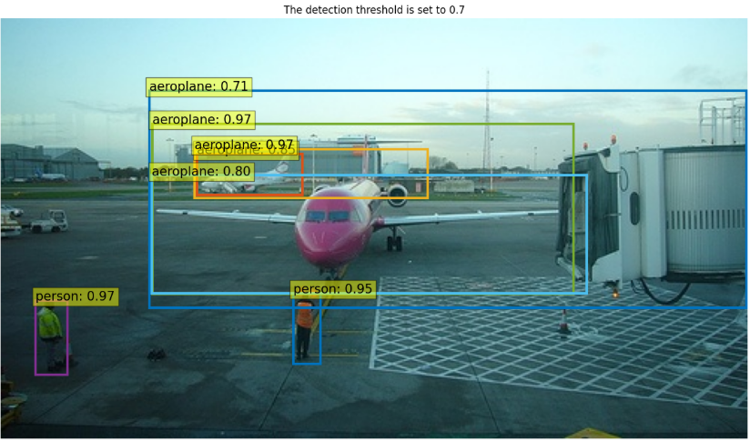
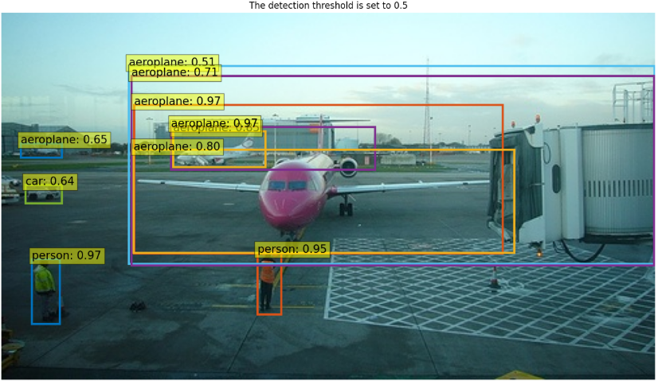

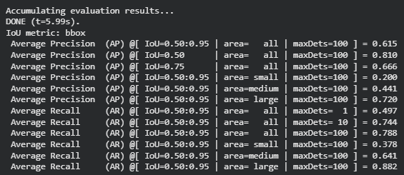

Improvement #1 (Improve Accuracy)
Hyperparams Used:
num_dn_groups = 5
Label_noise_ratio = 0.2
Box_noise_scale= 0.4
Training Time = ~170 minutes
Accuracy = 61.5%
Avg Inference Time = 0.0843s
#Params = 41,645,018
Source:
F. Li, H. Zhang, S. Liu, J. Guo, L. M. Ni, and L. Zhang, “DN-DETR: Accelerate DETR Training by Introducing Query DeNoising,” arXiv:2203.01305, 2022.

Slide 15
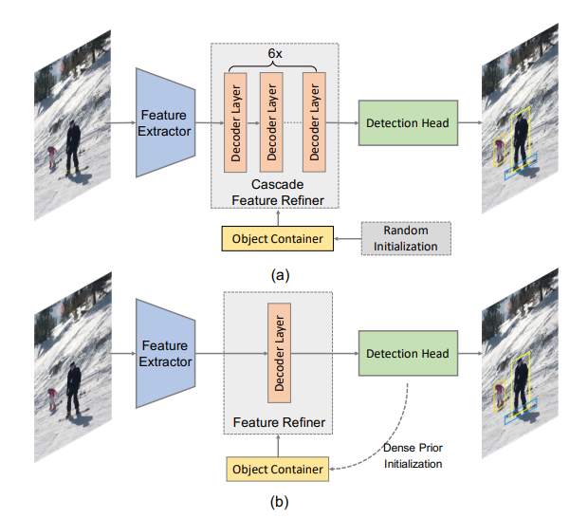
Improvement #2 (Improve Computation + Inference)
Problem:
Decoder layers take time and recourses
Computed self and cross attention
Main bottleneck
Deep decoders have object queries communicate too much:
causes over-correlation
removing specialization
Solution:
Reduce decoder layer to 4
Reduces FLOPs and memory
Reduces over-correlation
Very little accuracy loss
Source:
Z. Yao, Y. Ai, L. Gao, and B. Li, “Efficient DETR: Improving End-to-End Object Detector with Dense Prior,” arXiv:2104.01318, 2021.

Slide 16
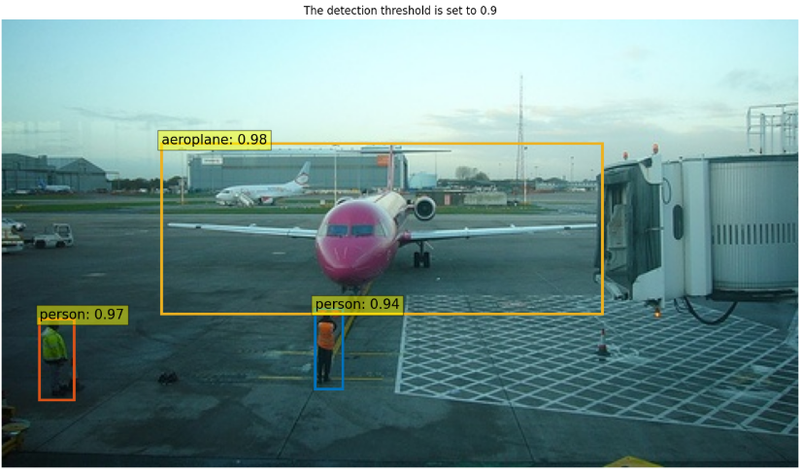
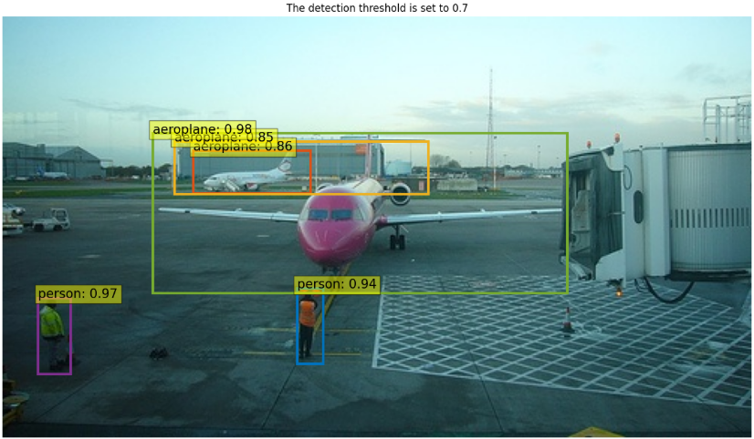
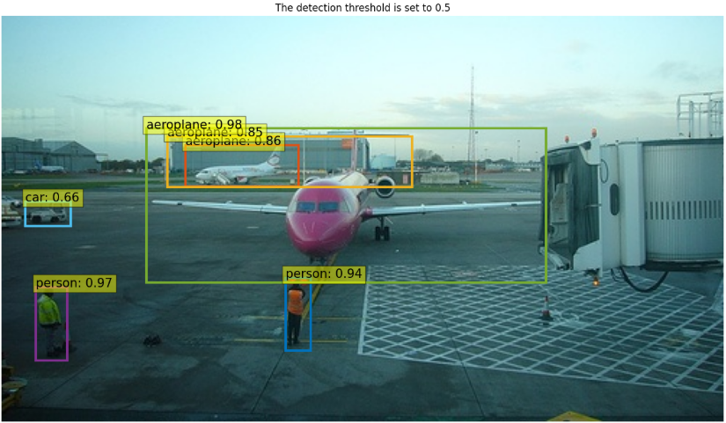
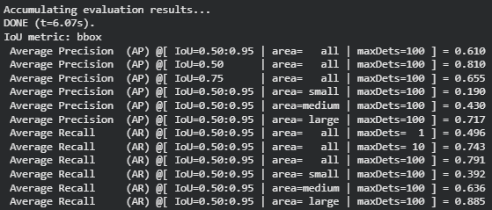
Improvement #2 (Improve Computation + Inference)
Hyperparams Used:
num_dn_groups = 5
Label_noise_ratio = 0.2
Box_noise_scale= 0.4
dec_layers = 4
Training Time = ~160 minutes
Accuracy = 61%
Avg Inference Time = 0.0832s
#Params = 38,487,514
Source:
Z. Yao, Y. Ai, L. Gao, and B. Li, “Efficient DETR: Improving End-to-End Object Detector with Dense Prior,” arXiv:2104.01318, 2021.

Slide 17
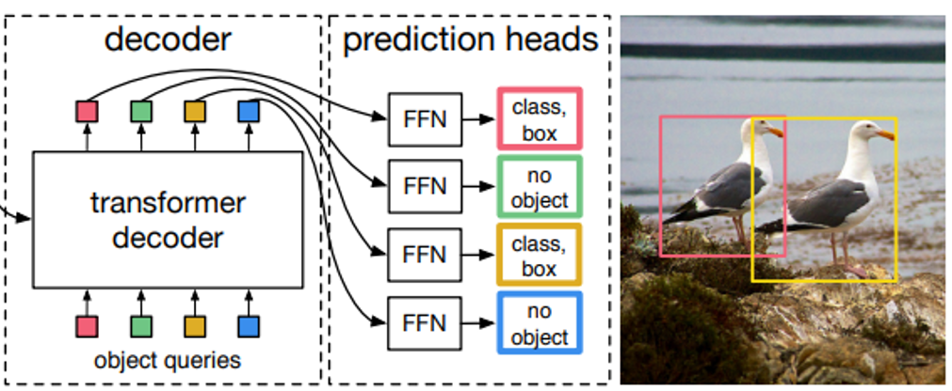
Improvement #3 (Improve Computation + Inference)
Problem:
Each query detect an object + location
Cross attention scales with # of queries
100 queries can be redundant on dataset of 20 classes
Solution:
Reduce # queries to 50
Force specialization
Reduce redundant computations
*Note: Even though source paper reduces #queries for each image, the idea and evidence of reduced queries was inspired by that paper
Source:
Z. Xu, S. Wang, H. Yu, and G. Zhang, “DQ-DETR: DETR with Dynamic Query for Tiny Object Detection,” arXiv:2404.03507, 2024.

Slide 18
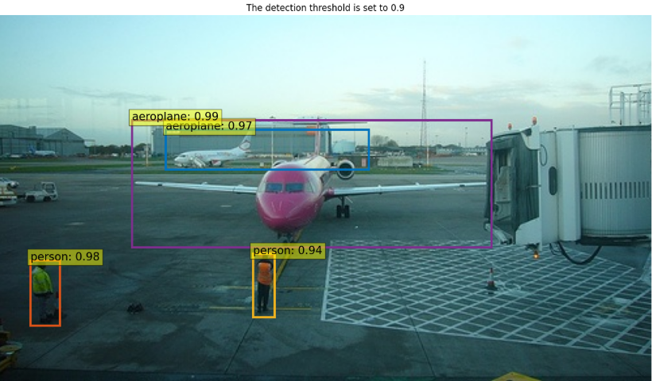
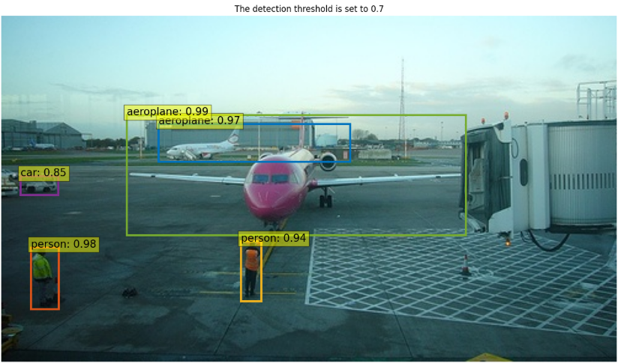
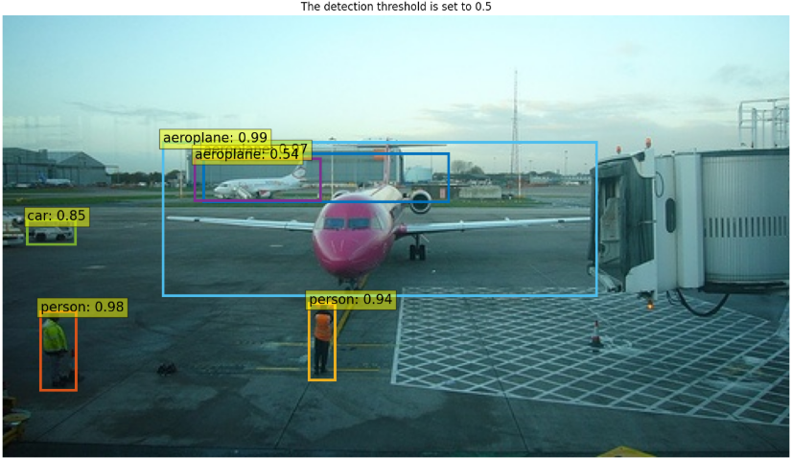
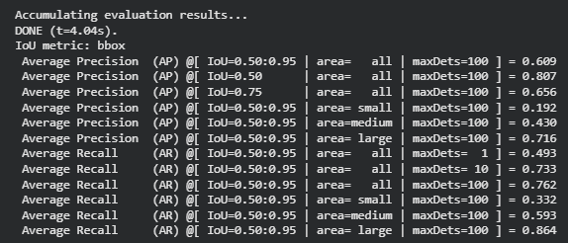
Improvement #3 (Improve Computation + Inference)
Hyperparams Used:
num_dn_groups = 5
Label_noise_ratio = 0.2
Box_noise_scale= 0.4
dec_layers = 4
num_queries = 50
resize_queries
Training Time = ~160 minutes
Accuracy = 60.9%
Avg Inference Time = 0.0828s
#Params = 38,474,714
Source:
Z. Xu, S. Wang, H. Yu, and G. Zhang, “DQ-DETR: DETR with Dynamic Query for Tiny Object Detection,” arXiv:2404.03507, 2024.

Slide 19
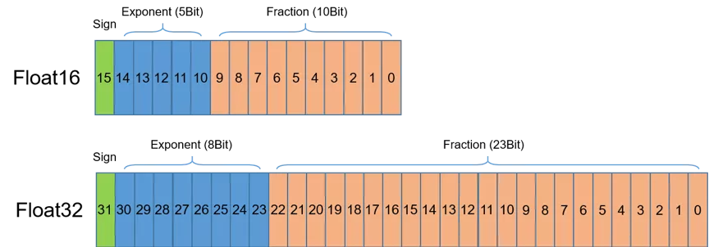
Improvement #4 (Improve Computation + Inference)
Problem:
Normal training uses FP32 for everything
FP32 is slow and heavy to compute
Solution:
Use Automatic Mixed Precision Training
Automatically used FP16 where it is safe to avoid computational errors
Improved training speed and mess memory with no accuracy loss
Source:
F. Li, H. Zhang, S. Liu, J. Guo, L. M. Ni, and L. Zhang, “DN-DETR: Accelerate DETR Training by Introducing Query DeNoising,” arXiv:2203.01305, 2022.

Slide 20
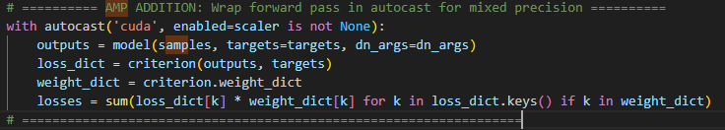
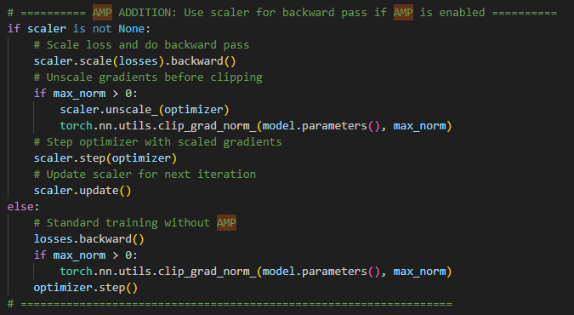
Improvement #4 (Improve Computation + Inference)
How its implemented:
engine.py
Source:
F. Li, H. Zhang, S. Liu, J. Guo, L. M. Ni, and L. Zhang, “DN-DETR: Accelerate DETR Training by Introducing Query DeNoising,” arXiv:2203.01305, 2022.

Slide 21
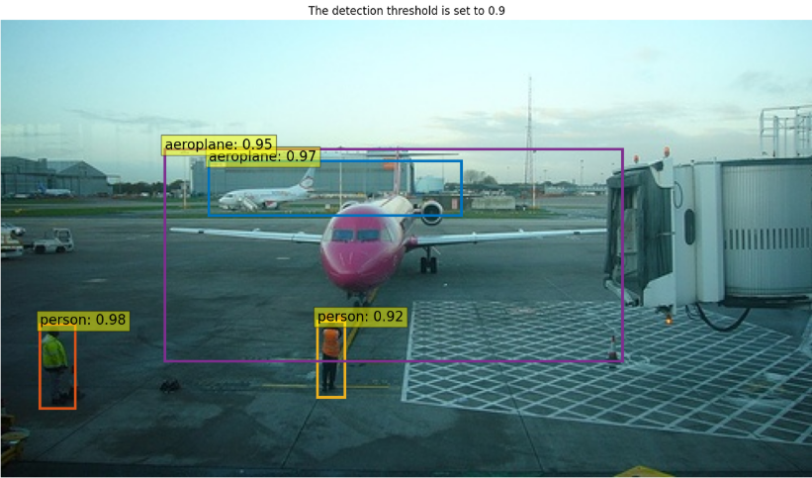
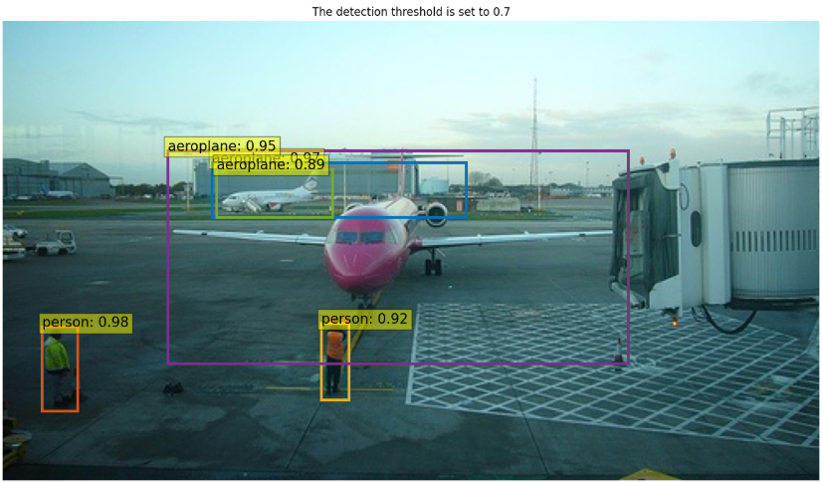
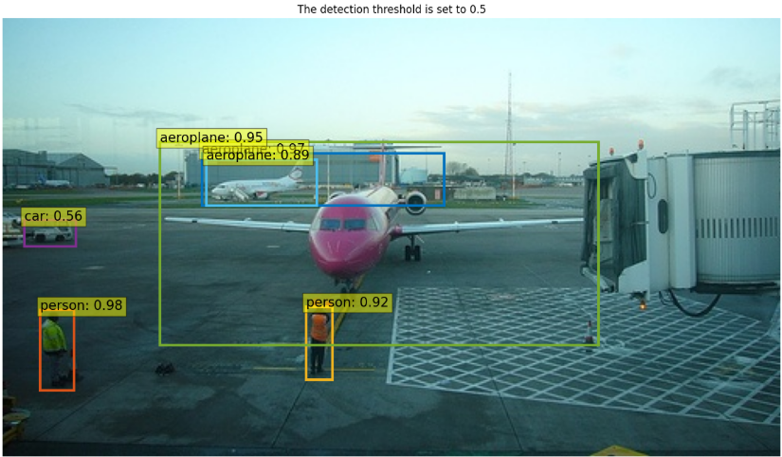
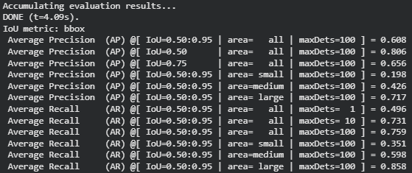
Improvement #4 (Improve Computation + Inference)
Hyperparams Used:
num_dn_groups = 5
Label_noise_ratio = 0.2
Box_noise_scale= 0.4
dec_layers = 4
num_queries = 50
resize_queries
amp
Training Time = ~110 minutes
Accuracy = 60.8%
Avg Inference Time = 0.0582s
#Params = 38,474,714
Source:
F. Li, H. Zhang, S. Liu, J. Guo, L. M. Ni, and L. Zhang, “DN-DETR: Accelerate DETR Training by Introducing Query DeNoising,” arXiv:2203.01305, 2022.

Slide 22
Evaluation

Slide 23
Evaluation
Default DETR Model
Training time: ~160 minutes
Accuracy = 60%
Avg Inference time = 0.0844 ~11.8fps
#Params = 41,506,778
DN-DETR + 4 Dec layers + 50 queries + AMP
Training Time = ~110 minutes
Accuracy = 60.8%
Avg Inference Time = 0.0582s ~17fps
#Params = 38,474,714

Slide 24
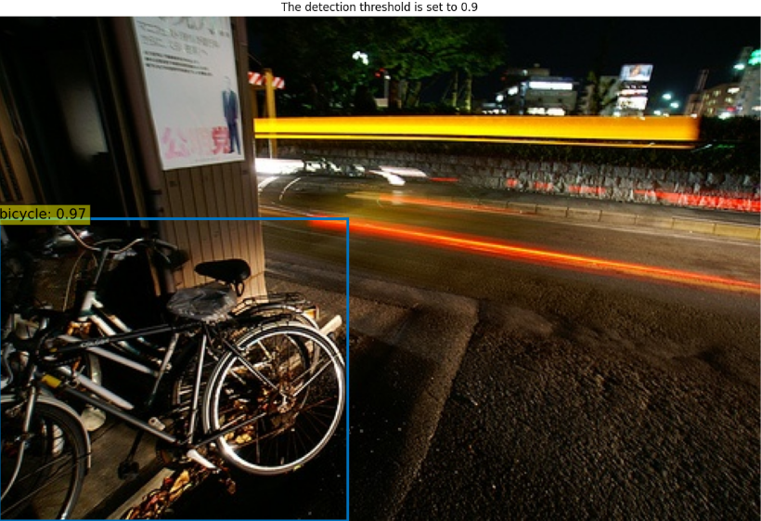
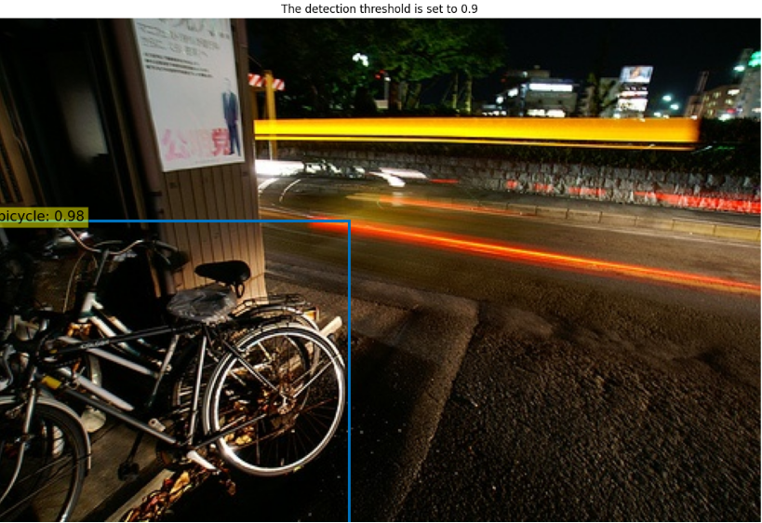
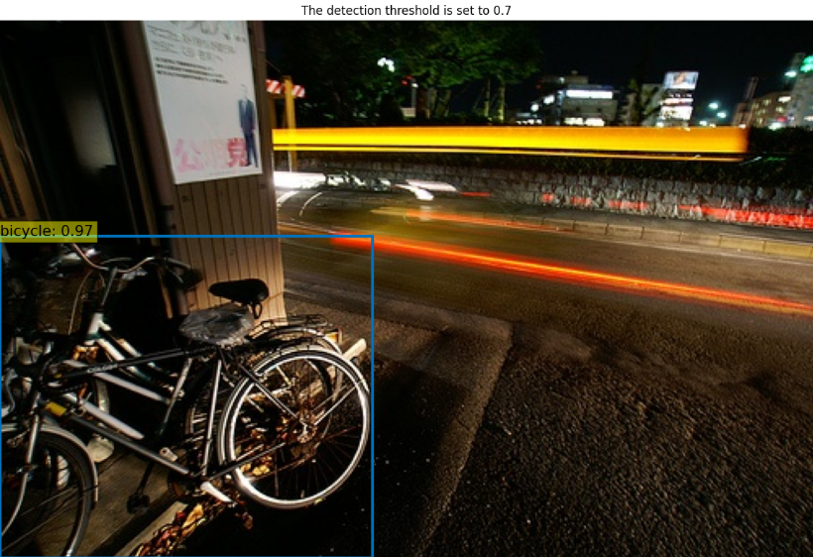


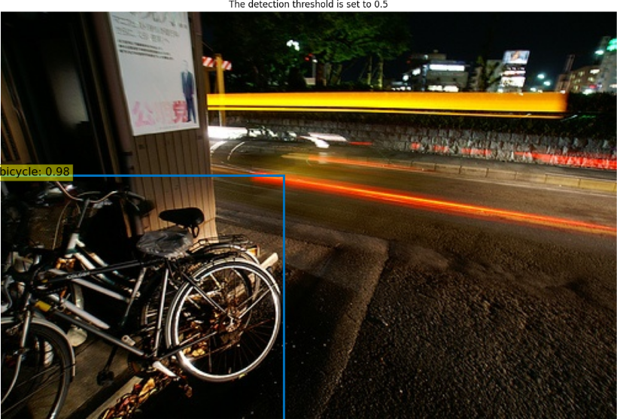
Evaluation

Slide 25
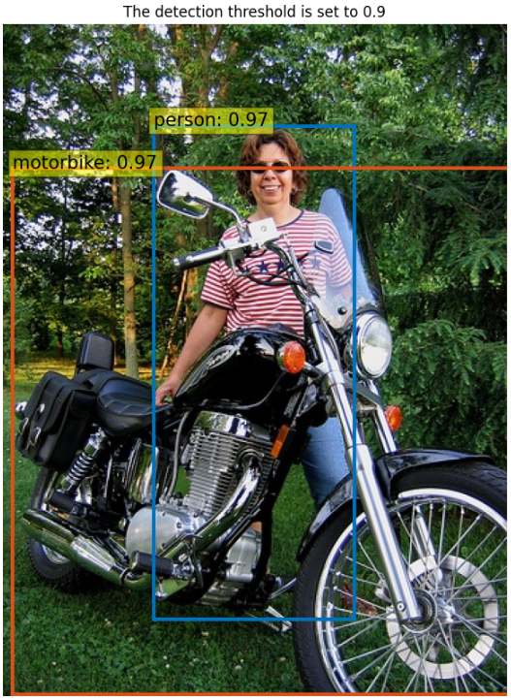
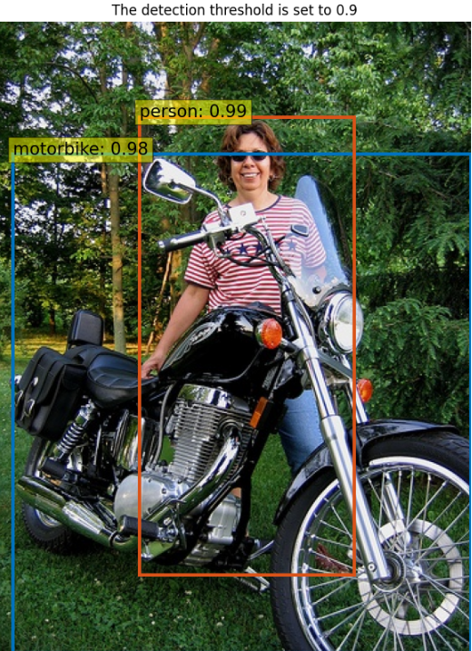
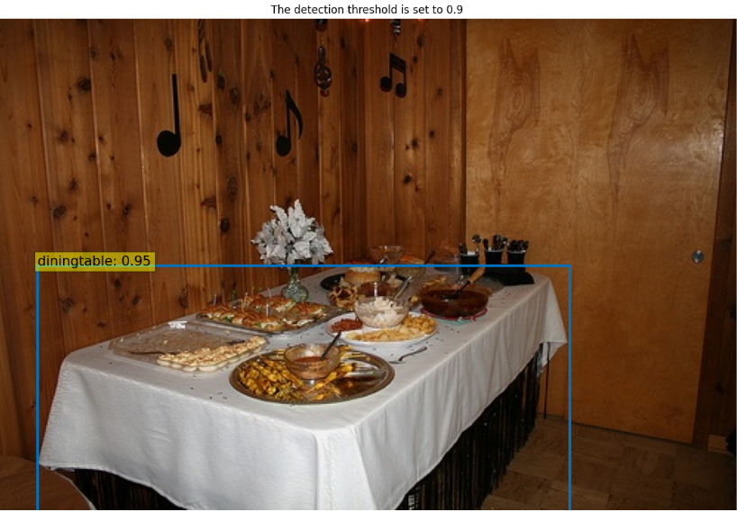


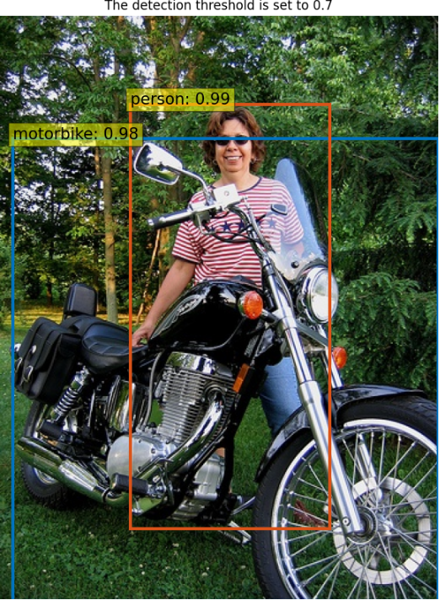
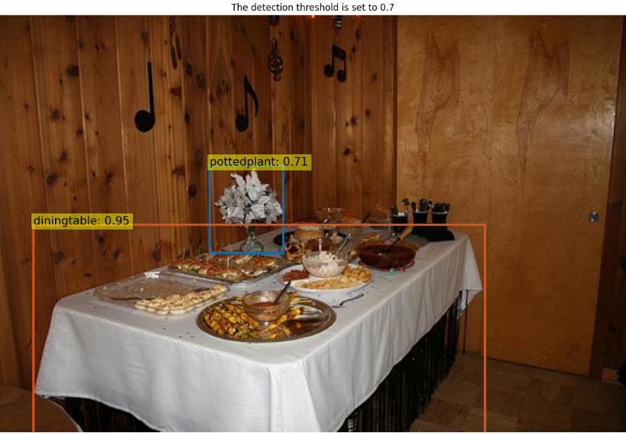



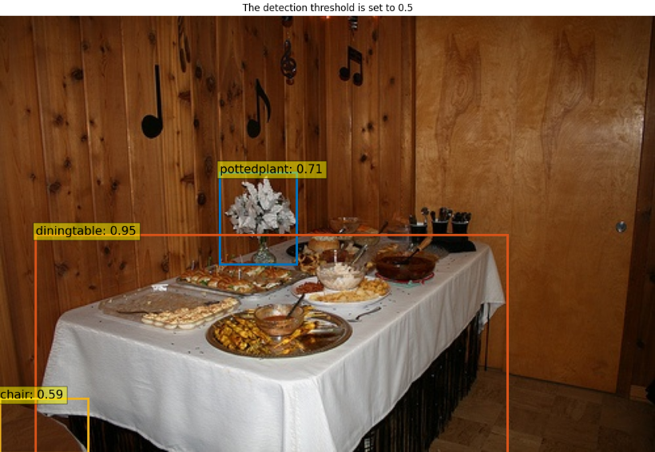
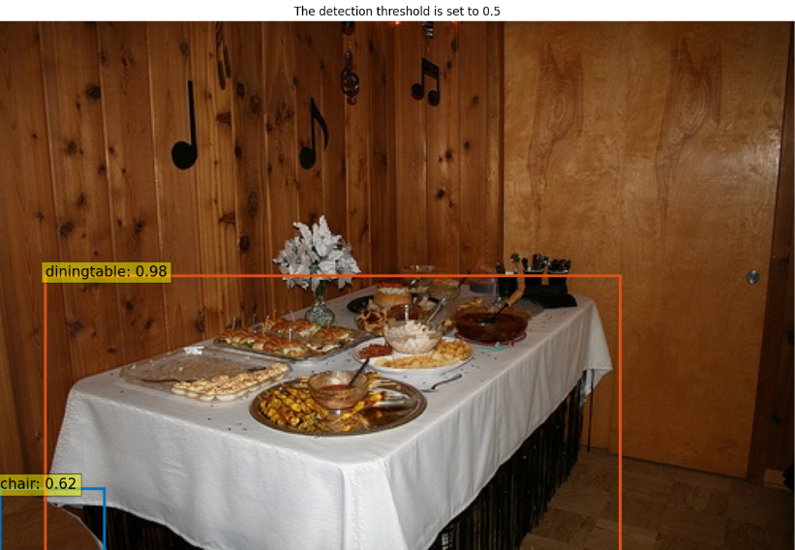
Evaluation

Slide 26
Conclusion

Slide 27
Conclusion
DN-DETR
Lower Decoder Layers + 50 Queries
Automatic Mixed Precision

Slide 28

Thank You

